Slide 1

eduVPN Institute Access as a Managed Service
Model currently implemented in the Netherlands
eduVPN instance managed centrally by SURFnet
Lightpath back to the private resource
Support by SURFnet
No need for hardware on campus or licensing limitations

Slide 2
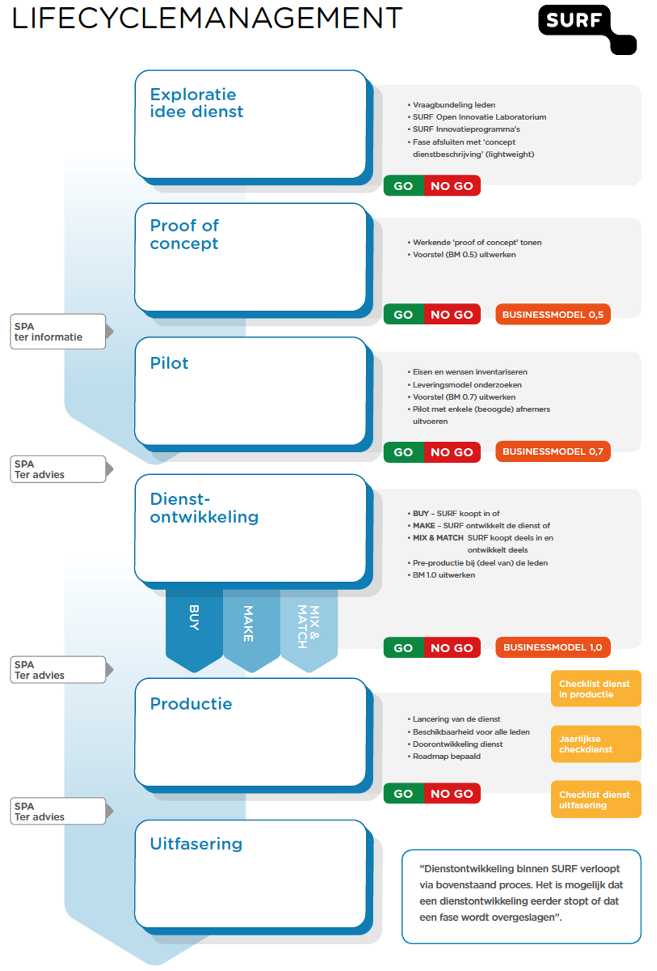
Life cycle & portfolio management

Slide 3
Life cycle & portfolio management: steps
The business model has three phases. Every phase requires approval.
Final version 1.0, contains: SLA, DAP, GDPR compliance, risk analyses, contract outsourcing partner, business case calculations

Slide 4
eduVPN pricing in .NL
Total Size institute | Costs
0 – 1.000 | € 100,00 per month
1.001 – 5.000 | € 500,00 per month
5.001 – 15.000 | € 850,00 per month
15.001+ | € 1.250,00 per month
This pricing model is inspired on the expected costs of maintaining a commercial VPN concentrator. Idea is that the eduVPN service should be the same price level as ‘running your own commercial VPN box’. In this way every institute should be able to afford the service.
Institute access Lightpath costs are NOT included!

Slide 5
How to ‘sell’ eduVPN
Establish eduVPN as your ‘official’ NREN service
Guarantee the service for at least 3-4 years
Be sure you’ve enough knowledge about the product in order to convince an institute
Make sure support is available
Key is integration with your federation service

Slide 6
How to ‘sell’ eduVPN (SURFnet strategy)
Marketing & communication aspects
Few times tech presentation at .NL CSIRT meetings
Service launch @annual security conference
Offer trial accounts to people in the CSIRT community
“try out a few months” for free
First year low price ->“how it’s being used”
Have trustworthy people involved
Security/crypto implemented like .NL government
GDPR compliant
Audits on all components
Mention eduVPN @community meetings

Slide 7
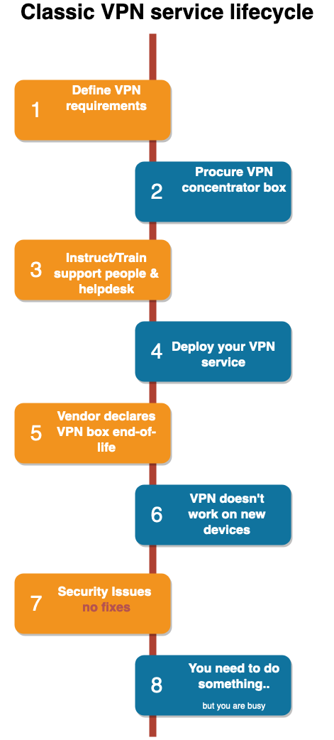

Slide 8
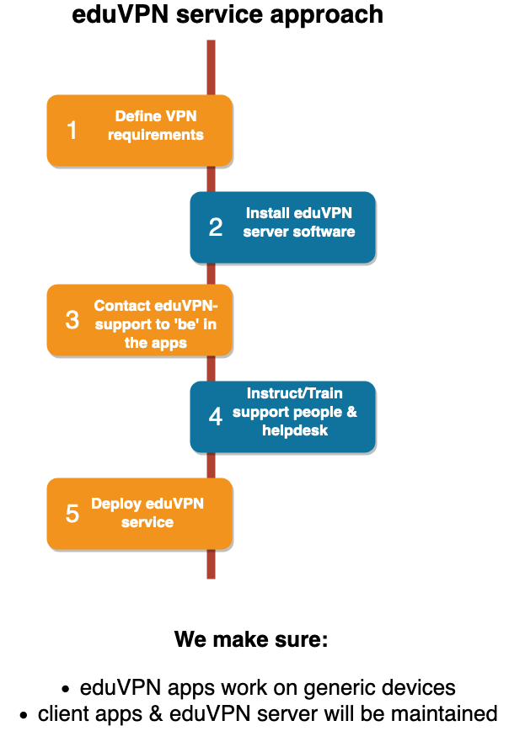

Slide 9
How to ‘sell’: question to ask
Students are used to commercial and ’shady’ free VPN products. These products always have the ability to ‘switch country’.
Is your current VPN concentrator solution an attractive alternative? Or will they probably continue to use those shady tools inside your organization.

Slide 10
How to ‘sell’: eduVPN world domination ;-)

Slide 11
How to manage the service (outsourcing)
The eduVPN maintenance (eduVPN server upgrades, OS updates, VM configuration, SAML configuration) has been outsourced
We searched for a partner with VPN knowledge: Greenhost.nl
Greenhost.nl does all change management and uses ansible scripts
-> future offer support via GEANT (?)

Slide 12
Institute access experiences
Setup of institute access takes quite some effort
We use a questionnaire to ask how an institute likes to use institute access. Find out if they need VLAN’s, ipranges, which user groups etc
We schedule a personal intake meeting onsite with IdM, network, security, workstation and other people
In general we visit the institute roughly 3 times in order to discuss the details of the setup.
Many emails to discuss, technical details.

Slide 13
Institute access redundant design (current)
Customer datacenters
SURFnet backbone
SURFnet datacenters

Slide 14
Institute access redundant design (maybe future)
SN8
EVPN
SN8
Customer
SURF
SN8
SN8
Static route
to 10.0.0.4
switch
Router
10.0.0.5
VRRP address 10.0.0.4 on both routers
EDU VPN VM
10.0.0.2
switch
10.0.0.6
Router
SN8
SN8
SN8
SN8
ESI
ESI
VRRP 10.0.0.0/29 subnet

Slide 15
Experiences in the field
Use eduVPN for bulk-VPN.
Institute Access: Only create a few profiles.
Managed Institute Access: experience like a cloud service
One institute likes to receive syslog, to be more in control
Windows app: Antivirus technology uses whitelisting -> can’t release new executables directly
One university forces re-login every 12 hours -> is this handy?

Slide 16
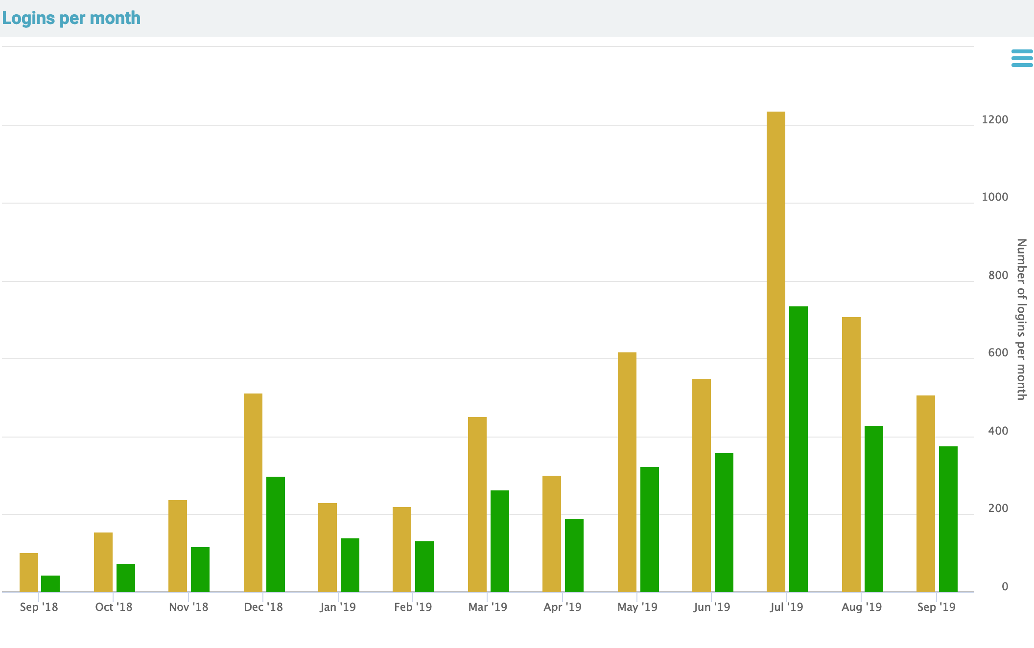
SP login: total vs unique users

Slide 17
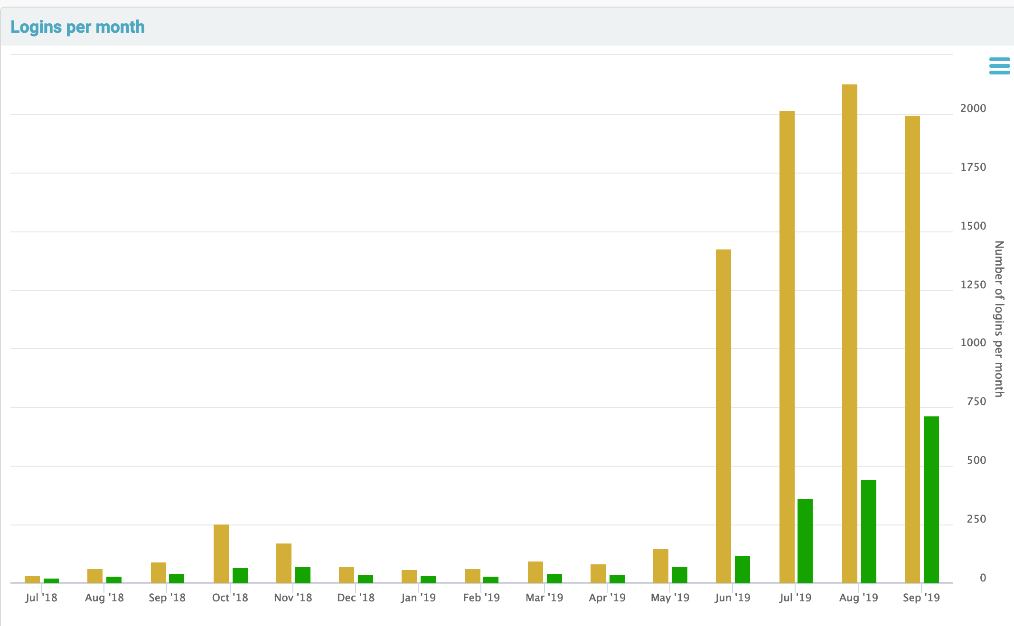
2FA login & sessions expire after 12 hrs

Slide 18
Currently 12 paying customers in .NL
Universities: RU, VU , EUR, LeidenUniv (4)
Research/other: 4
Lower educational: 2
Polytechnique: 1
Other institutes: 1
Reason why some not interested:
Recently moved to new VPN concentrator/firewall
A full redundant setup was difficult to integrate with local network
Recently bought firewall has VPN feature too
Like to do it themselves
Everything is in the cloud “we don’t need VPN”
They want managed device VPN

Slide 19
Enthusiastic users
“It even works in China”
”It works quite nicely”
“I can watch Dutch soccer when travelling”
“Finally a solution to get around GEOblocking”

